Slide 1
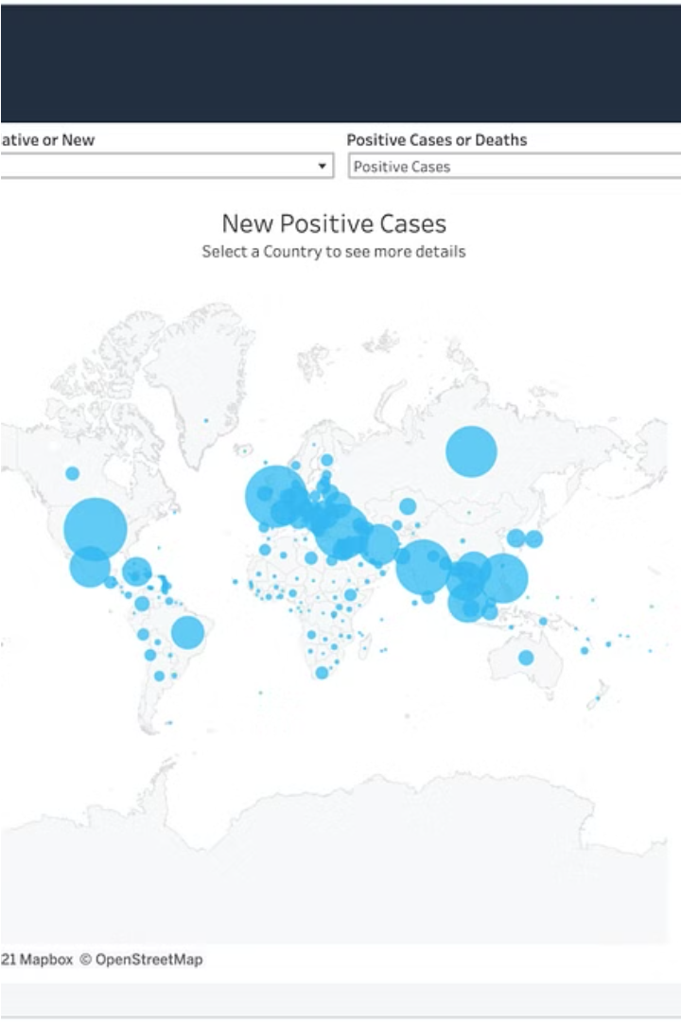
Analyzing the COVID-19 Pandemic 2020-2021
The COVID-19 pandemic has had a significant impact on public health worldwide, creating an urgent need for data-driven insights to understand the spread of the virus. As a data analyst, I have been tasked with analyzing a COVID-19 dataset to derive meaningful insights and present my findings.
by Kuburat Aliyu
Ka
Notes:
Hello, my name is Aliyu Kuburat, and I analyzed the dataset on the COVID-19 pandemic. Although there is much insight that could be derived from this data, but I focused on specific objectives. Please note that all analyses and recommendations are entirely based on the dataset.
The COVID-19 pandemic has greatly impacted people's health globally, making it crucial to use data to gain insights into how the virus is spreading. As a data analyst, I have been responsible for analyzing a COVID-19 dataset to extract valuable insights and present my findings.

Slide 2
DATASET FOR THE PROJECT
Description of each column in dataset:
Province: Geographic subdivision within a country/region.
Country/Region: Geographic entity where data is recorded.
Latitude: North-south position on Earth's surface.
Longitude: East-west position on Earth's surface.
Date: Recorded date of CORONA VIRUS data.
Confirmed: Number of diagnosed CORONA VIRUS cases.
Deaths: Number of CORONA VIRUS related deaths.
Recovered: Number of recovered CORONA VIRUS cases.
Notes:
I analyzed and cleaned this dataset using SQL, did some cleaning and cross-checked my query results using Excel.
"That's the provided data for the project."

Slide 3
Exploring the COVID-19 Dataset
Data Extraction
Data Exploration
I began by extracting the first 1,000 rows of the dataset and importing them into a MySQL database to ensure the data was in a usable format. This allowed me to identify and address any data inconsistencies, such as issues with the date column.
With the data in a clean and consistent state, I proceeded to explore the dataset, analyzing the start and end dates, the number of months covered, and calculating monthly averages for confirmed cases, deaths, and recoveries.
2
3
Data Cleaning
After importing the full dataset, I checked for any NULL values and converted to MySQL approved date format, YYYY-MM-DD to ensure accurate analysis.
Notes:
To ensure the data was ready for analysis, I imported the first 1000 rows into MySQL. I encountered an issue with some inconsistent date data and used Excel's "text to column" and formatting feature to fix it. After confirming everything was okay, I imported the entire dataset for analysis.

Slide 4
Identifying Trends and Patterns
Monthly Trends
Geographical Insights
Recovery Rates
To gain a deeper understanding of the COVID-19 pandemic, I analyzed the monthly trends for confirmed cases, deaths, and recoveries. This allowed me to identify the most frequent values for each metric, as well as the minimum and maximum values per year.
I also explored the geographical aspects of the dataset, identifying the country with the highest number of confirmed cases and the country with the lowest number of deaths. This provided valuable insights into the uneven impact of the pandemic across different regions.
To understand the recovery efforts, I analyzed the total number of recovered cases per month and identified the top 5 countries with the highest recovered cases. This information can help inform public health strategies and resource allocation.
Notes:
I Identified monthly trends, geographical insights and Recovery rates

Slide 5
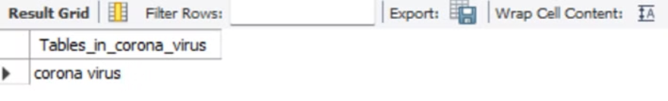
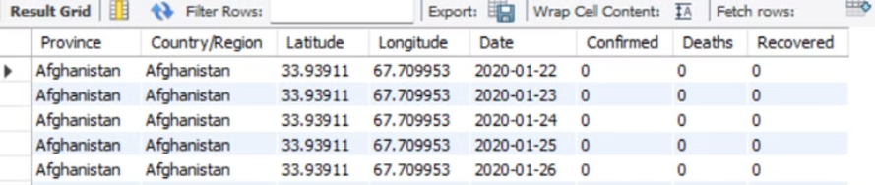
Analyzing the Spread of COVID-19
Analysis
SHOW TABLES;
SELECT * FROM corona_virus. corona virus;
Notes:
Started the Analysis by checking the table and columns in the data and getting more familiar with all the information provided

Slide 6
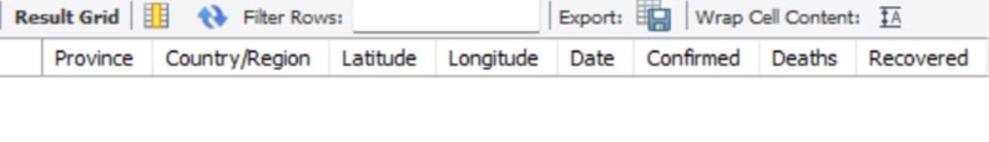
1. Write a code to check NULL values
SELECT * FROM corona_virus. corona virus
WHERE Province IS NULL;
Alternative query…
SELECT * FROM corona_virus. corona virus
WHERE COALESCE (Longitude, '') = '';
Notes:
There was no null value in the data

Slide 7
2. If NULL values are present, update them with zeros for all columns.
There was no null value present in the data
Notes:
9

Slide 8
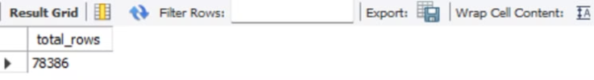
3. Check total number of rows
SELECT COUNT (*) AS total_rows
FROM corona_virus. corona virus;
Notes:
Total data set 78,386

Slide 9
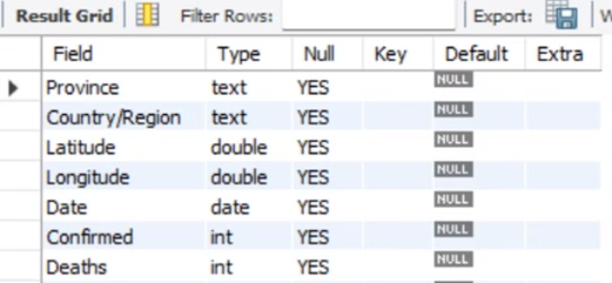
ALTER TABLE corona_virus.`corona virus`
MODIFY Date date;
Needed to modify the date column to a date data type
I check if it was properly updated by this query:
DESCRIBE corona_virus. corona virus;
SHOW COLUMNS FROM corona_virus. corona virus;
Notes:
I had to modify the date column and did a check

Slide 10
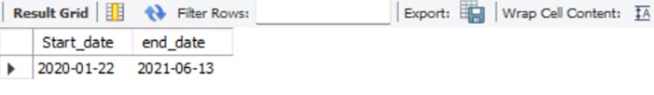
4. Check what is start_date and end_date
SELECT MIN(Date) AS Start_date, MAX(Date) AS end_date
FROM corona_virus. corona virus;
Notes:
Start date is 2020 and end date is 2021.

Slide 11
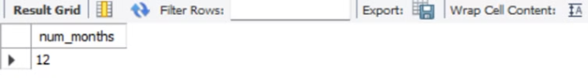
5. Number of months present in dataset
SELECT COUNT (DISTINCT MONTH(Date)) AS num_months
FROM corona_virus. corona virus;
Notes:
There are 12 months in the data. January-december

Slide 12
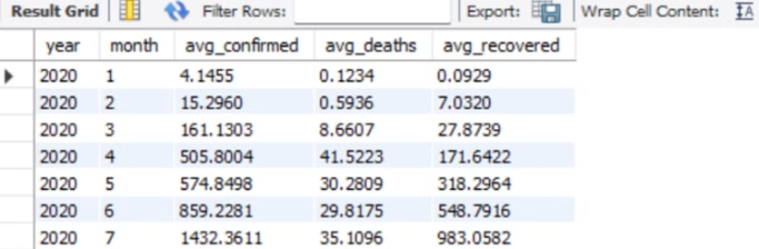
6. Find monthly average for confirmed, deaths, recovered
SELECT YEAR (date) AS year,
MONTH (date) AS month,
AVG (confirmed) AS avg_confirmed,
AVG (deaths) AS avg_deaths,
AVG (recovered) AS avg_recovered
FROM corona_virus. corona virus
GROUP BY YEAR (date), MONTH (date)
ORDER BY YEAR (date), MONTH (date);
Notes:
Death record has the least avg

Slide 13
7. Find most frequent value for confirmed, deaths, recovered each month
SELECT
YEAR('date') AS year,
MONTH('date') AS month,
confirmed_mode AS most_frequent_confirmed,
deaths_mode AS most_frequent_deaths,
recovered_mode AS most_frequent_recovered
FROM (
SELECT
YEAR('date') AS year,
MONTH('date') AS month,
confirmed,
deaths,
recovered,
ROW_NUMBER () OVER (PARTITION BY YEAR('date'), MONTH('date') ORDER BY COUNT (*) DESC) AS rn_confirmed,
ROW_NUMBER () OVER (PARTITION BY YEAR('date'), MONTH('date') ORDER BY COUNT (*) DESC) AS rn_deaths,
ROW_NUMBER () OVER (PARTITION BY YEAR('date'), MONTH('date') ORDER BY COUNT(*) DESC) AS rn_recovered,
Notes:
20

Slide 14
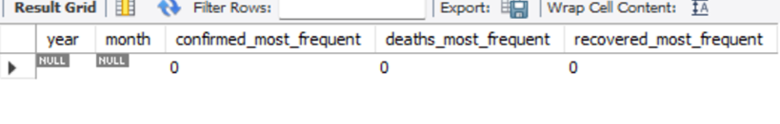
Question 7 Continues....
MAX (confirmed) AS confirmed_mode,
MAX (deaths) AS deaths_mode,
MAX (recovered) AS recovered_mode
FROM
corona_virus. `corona virus`
GROUP BY
YEAR('date'), MONTH('date'), confirmed, deaths, recovered
) AS monthly_data
WHERE
rn_confirmed = 1 AND rn_deaths = 1 AND rn_recovered = 1;
Notes:
0 is the most frequent value across confirmed, death and recovered record

Slide 15
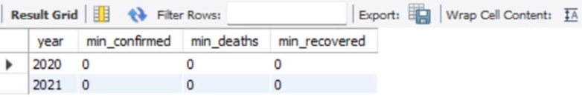
8. Find minimum values for confirmed, deaths, recovered per year
SELECT
YEAR(Date) AS year,
MIN (confirmed) AS min_confirmed,
MIN (deaths) AS min_deaths,
MIN (recovered) AS min_recovered
FROM
corona_virus. corona virus
GROUP BY
YEAR(Date);
Notes:
O is also the minimum value across 2020 and 2021

Slide 16
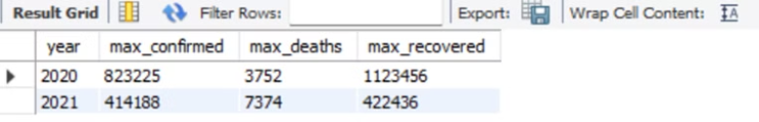
9. Find maximum values of confirmed, deaths, recovered per year
SELECT
YEAR(Date) AS year,
MAX (confirmed) AS max_confirmed,
MAX (deaths) AS max_deaths,
MAX (recovered) AS max_recovered
FROM
corona_virus. corona virus
GROUP BY
YEAR(Date);
Notes:
Death has the maximum record count

Slide 17
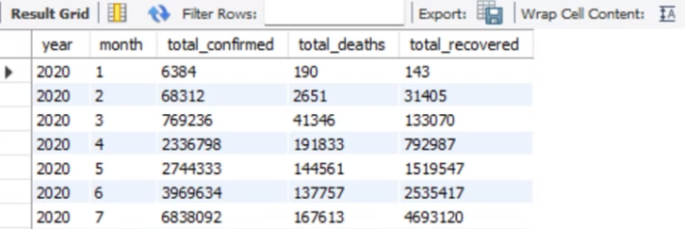
10. The total number of cases of confirmed, deaths, recovered each month
SELECT
YEAR(Date) AS year,
MONTH(Date) AS month,
SUM (confirmed) AS total_confirmed,
SUM (deaths) AS total_deaths,
SUM (recovered) AS total_recovered
FROM
corona_virus. corona virus
GROUP BY
YEAR(Date), MONTH(Date);
Notes:
Confirmed cases have the highest number of recorded cases

Slide 18
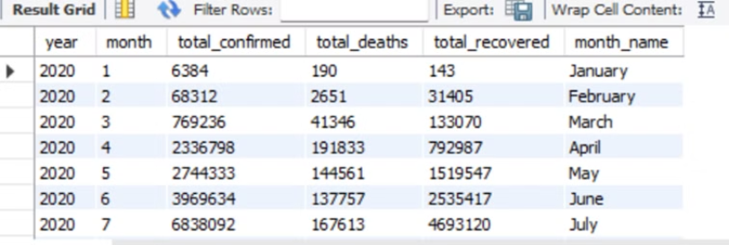
A Month Query, Continuation of Question 10
SELECT
YEAR(Date) AS year,
MONTH(Date) AS month,
SUM (confirmed) AS total_confirmed,
SUM (deaths) AS total_deaths,
SUM (recovered) AS total_recovered,
DATE_FORMAT (Date, '%M') AS month_name
FROM corona_virus. corona virus
GROUP BY YEAR(Date), MONTH(Date), month_name;
Notes:
29

Slide 19
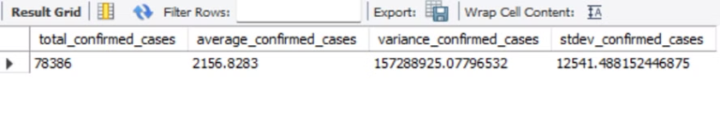
11. Check how corona virus spread out with respect to confirmed case. (E.g.: total confirmed cases, their average, variance & STDEV)
SELECT COUNT (*) AS total_confirmed_cases,
AVG (confirmed) AS average_confirmed_cases,
VARIANCE (confirmed) AS variance_confirmed_cases,
STDDEV (confirmed) AS stdev_confirmed_cases
FROM corona_virus. corona virus;
Notes:
Confirmed cases have high standard deviation and variance, indicating variability in the confirmation rate across the dataset, there is an increasing rate of confirmed cases.

Slide 20
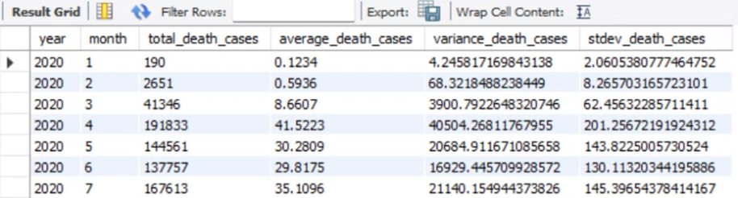
12. Check how corona virus spread out with respect to death case per month. -- (E.g.: total confirmed cases, their average, variance & STDEV)
SELECT YEAR (date) AS year,
MONTH (date) AS month,
SUM (deaths) AS total_death_cases,
AVG (deaths) AS average_death_cases,
VARIANCE (deaths) AS variance_death_cases,
STDDEV (deaths) AS stdev_death_cases
FROM corona_virus. corona virus
GROUP BY YEAR (date), MONTH (date);
Notes:
The number of deaths per month has been increasing with a wider range of variation.

Slide 21
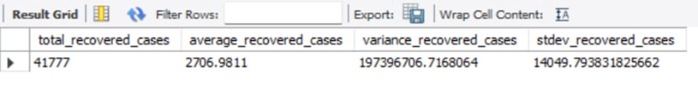
13. Check how corona virus spread out with respect to recovered case. -- (E.g.: total confirmed cases, their average, variance & STDEV)
SELECT COUNT (*) AS total_recovered_cases,
AVG (recovered) AS average_recovered_cases,
VARIANCE (recovered) AS variance_recovered_cases,
STDDEV (recovered) AS stdev_recovered_cases
FROM corona_virus. corona virus
WHERE recovered > 0;
Notes:
A high standard deviation means scattered data and a high variance confirms significant variability in the dataset's recovered cases. Recovery rate differs significantly among observed cases, and some regions or populations may have higher recovery rates than others. But generally, there is a high recovery rate.

Slide 22
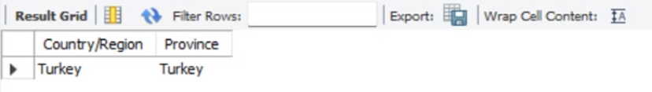
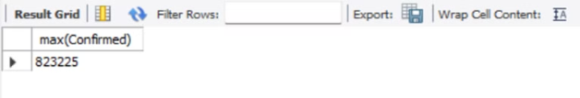
14. Find Country having highest number of the Confirmed case
SELECT Country/Region, Province
FROM corona_virus. corona virus
WHERE confirmed = (
SELECT MAX (confirmed)
FROM corona_virus. corona virus
);
--A check Query
Select max (Confirmed) FROM corona_virus. corona virus
WHERE Country/Region= 'Turkey';
Notes:
Turkey is the country with the highest confirmed case

Slide 23
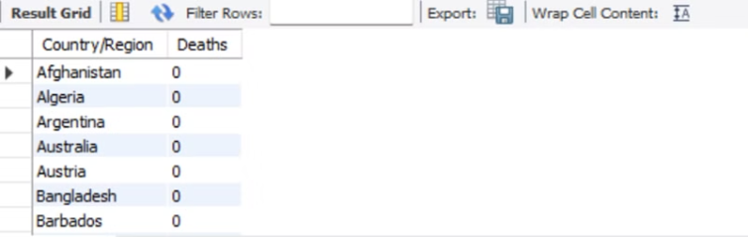
15. Find Country having lowest number of the death case
SELECT DISTINCT (`Country/Region`), Deaths
FROM corona_virus. corona virus
WHERE deaths = (
SELECT MIN (deaths)
FROM corona_virus. corona virus
);
Notes:
Countries with the lowest number of death case

Slide 24
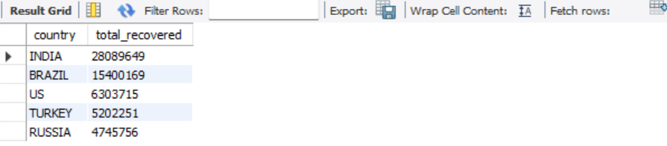
16. Find top 5 countries having highest recovered case
SELECT DISTINCT UPPER(TRIM(`Country/Region`)) AS country, SUM(recovered) AS total_recovered
FROM corona_virus.`corona virus`
GROUP BY UPPER(TRIM(`Country/Region`)) -- Group by the cleaned country name
ORDER BY total_recovered DESC
LIMIT 5;
Notes:
Top 5 countries are
India
Brazil
US
Turkey and
Russia

Slide 25
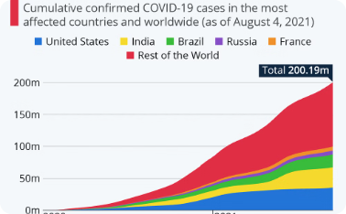
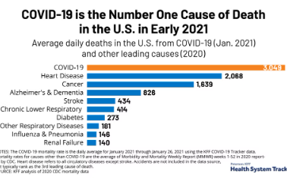
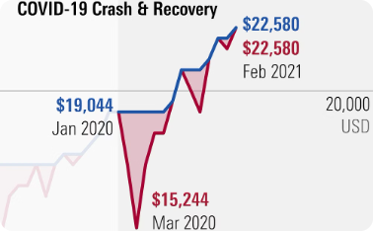
Visualizing the COVID-19 Pandemic
COVID-19 Death Toll
Recoveries from COVID-19
Confirmed Cases Over Time
The data also revealed a concerning number of COVID-19 deaths compared to other illness. The graph illustrates the importance of implementing robust public health strategies to mitigate the loss of life.
While the pandemic has been devastating, the data also shows the progress made in terms of COVID-19 recoveries. The graph depicts the increasing number of recovered cases, providing a glimmer of hope and highlighting the importance of continued efforts to support those affected by the virus.
The data analysis revealed a clear trend in the number of confirmed COVID-19 cases over time. The graph shows the steady increase in confirmed cases, highlighting the rapid spread of the virus and the need for effective containment measures.
Notes:
42

Slide 26



Insights and Recommendations
Key Findings
Implications
Recommendations
The analysis of the COVID-19 dataset has revealed several key insights, including the uneven impact of the pandemic across different regions, the fluctuations in confirmed cases, deaths, and recoveries over time, and the identification of the countries most severely affected by the virus.
These findings have important implications for public health policy and resource allocation, as they highlight the need for targeted interventions and the implementation of effective strategies to mitigate the spread of the virus and support those affected by it.
Based on the insights gained from this analysis, I recommend that policymakers and public health authorities focus on developing and implementing tailored strategies to address the specific challenges faced by the hardest-hit regions, while also investing in research and development to improve our understanding of the virus and enhance our ability to respond to future pandemics.
Notes:
COVID-19 data analysis reveals uneven impact across regions, fluctuations in cases and identified hardest-hit countries.

Slide 27




Visualizing the Spread of COVID-19
Confirmed Cases
COVID-19 Deaths
Recoveries
Geographical Impact
While the pandemic has been devastating, the data also showed progress in terms of COVID-19 recoveries, providing a glimmer of hope and highlighting the importance of continued efforts to support those affected by the virus.
The analysis revealed a significant increase in the number of confirmed COVID-19 cases over time, highlighting the rapid spread of the virus and the need for effective containment measures.
The data also showed a concerning trend in the number of COVID-19 deaths, underscoring the severity of the pandemic and the importance of implementing robust public health strategies to mitigate the loss of life.
The analysis revealed the uneven impact of the pandemic across different regions, with some countries being more severely affected than others. This underscores the need for targeted interventions and resource allocation based on the specific challenges faced by each region.
Notes:
44

Slide 28
Conclusion
Key Insights
- Uneven impact of the pandemic across different regions - Fluctuations in confirmed cases, deaths, and recoveries over time - Identification of the countries most severely affected by the virus
Implications
- Need for targeted interventions and resource allocation - Importance of developing and implementing effective public health strategies - Necessity of investing in research and development to enhance our understanding and response to future pandemics
Recommendations
- Focus on developing and implementing tailored strategies to address the specific challenges faced by the hardest-hit regions - Invest in research and development to improve our understanding of the virus and enhance our ability to respond to future pandemics - Collaborate with policymakers and public health authorities to ensure effective implementation of these strategies
Notes:
My recommendation is to focus on tailored strategies for the hardest-hit regions and invest in research to enhance our ability to respond to future pandemics.

Slide 29



The Path Forward
Ongoing Monitoring
The COVID-19 pandemic is an evolving situation, and it is crucial to continue monitoring the data and trends to ensure that public health strategies remain effective and responsive to the changing circumstances.
Collaborative Efforts
Addressing the challenges posed by the pandemic will require a collaborative effort among policymakers, public health authorities, healthcare providers, and the broader community. By working together, we can develop and implement comprehensive solutions to mitigate the impact of COVID-19 and prepare for future public health emergencies.
Embracing Innovation
The COVID-19 pandemic has highlighted the importance of innovation and technological advancements in the field of public health. By investing in research and development, we can enhance our understanding of the virus, improve our diagnostic and treatment capabilities, and develop more effective strategies to prevent and respond to future pandemics.
Notes:
Way Forward
Ongoing monitoring
Collaborations
and Embracing Innovation.

Slide 30
THANK YOU

